Slide 1

Capstone Design (2)
8th week : Life Sports Total Solution
Date | 2019.04.29
Presenter | 이동현
Team | 공찬형, 금강현, 이동현

Slide 2
Index
Project Concept
Just focus on the game itself
Play the game like ‘a Game’
Project Schedule
Implementation
Database data generation
Web page : Encoding problem
Hadoop Cluster Construction
Personal Project Scehdule
Q & A

Slide 3
Project Concept

Slide 4
1. Project Concept
Just focus on the game itself.
Making a regular reservation and participating the Open Matching by using app
Team management
Recommendation System
Recommend the best team you could join by analyzing your profile and records
Recommend the best opponent to compete with
Balanced matching through the data collected (Open Matching)
Team Name : star7
Team’s main subject : Soccer
Team Score : 145 / 157 (92%)
Recent Records :
S
star7 vs ABC | 3 : 2 (win)
star7 vs Korea | 4 : 1 (win)
star7 vs ABC | 1 : 0 (win)

Slide 5
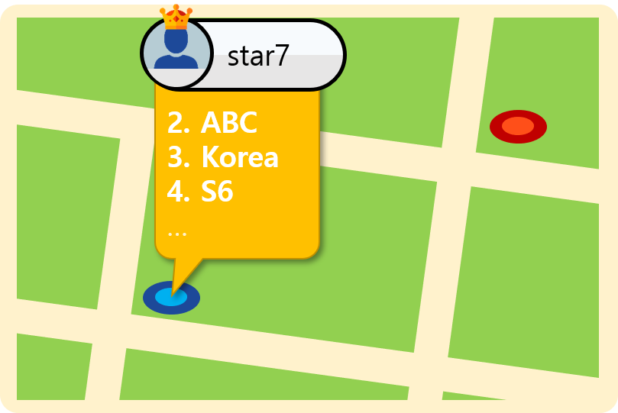
1. Project Concept
Play the game like ‘a Game.’
Ranking System
Gym Occupation
MMR(Match Making Rating)
Badge Achievement System
Sign up ➔ Profile Registration ➔ Joining team ➔ Placement test ➔ Matches…

Slide 6
Project Schedule

Slide 7
2. Project Schedule
Dates Task Descriptions | March |  |  |  | April |  |  |  |  | May |  |  |  | June
 | 4 | 11 | 18 | 25 | 1 | 8 | 15 | 22 | 29 | 6 | 13 | 20 | 27 | 3 | 10 | 17
Team Organization |  |  |  |  |  |  | Midterm Demonstration & Presentation |  |  |  |  |  |  | Final Demonstration & Presentation
Subject Confirmation / Write out the Proposal
Web UI Design
Web Structure Construction
Data collection & Generation / Data modeling
Database Construction
App UI Design
App Structure Construction
Functional Implementation : Manager Web Site
Functional Implementation : Reservation (App)
Hadoop Installation / CDH Cluster Construction
Data Analysis using Hadoop Cluster
Functional Implementation : Matching Service (App)
Functional Implementation : Ranking System (App)
Test and Debugging
Preparing for Final Demo
Writing Manuals and Reports

Slide 8
Implementation

Slide 9
3. Implementation : DB Data Generation
사용자 | User
사용자별관심종목 | pref_subj_per_user
사용자별 업적 | badge_per_user
축구전적 | soccer_record
야구전적 | baseball_record
농구전적 | basketball_record
배드민턴전적 | badminton_record
사용자별선호체육관 | pref_gym_per_user
사용자별선호체육시설 | pref_fac_per_user
팀 | team
팀별 업적 | badges_per_team
팀별선호체육관 | pref_gym_per_team
팀별선호체육시설 | pref_fac_per_team
팀별팀원목록 | team_user_list
경기결과 | match_result
경기참여자명단 | match_participant
예약경기 | reserv_matches
오픈매칭 | open_match
체육관 관리자 | gym_admin
체육관 | gym
시설정보 | fac_info
종목 | subject
업적 | badge
시설 일정 | fac_schedule
토너먼트 게시판 | tournament_board
토너먼트 | Tournament
토너먼트 일정 | tournament_schedule
# of tables : 27 tables
Data generated tables : 10 (37% completed)

Slide 10
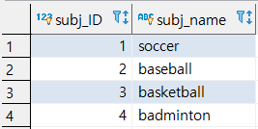
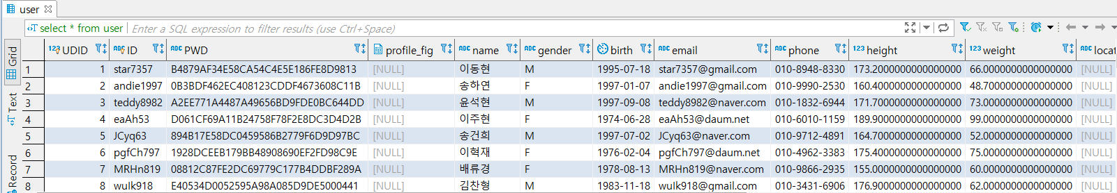
3. Implementation : DB Data Generation
Subject table (4 rows) : 4 subjects are supported.
User table (503 rows) : Contain user information / PWD Encrypted (AES Algorithm)

Slide 11
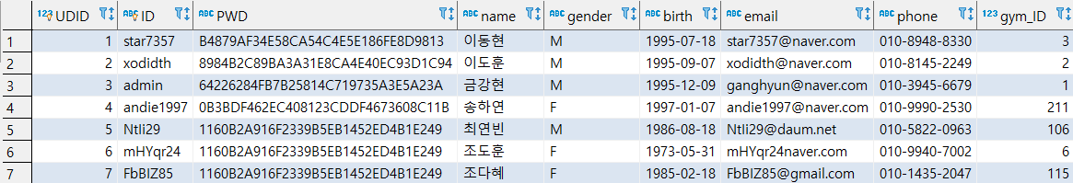
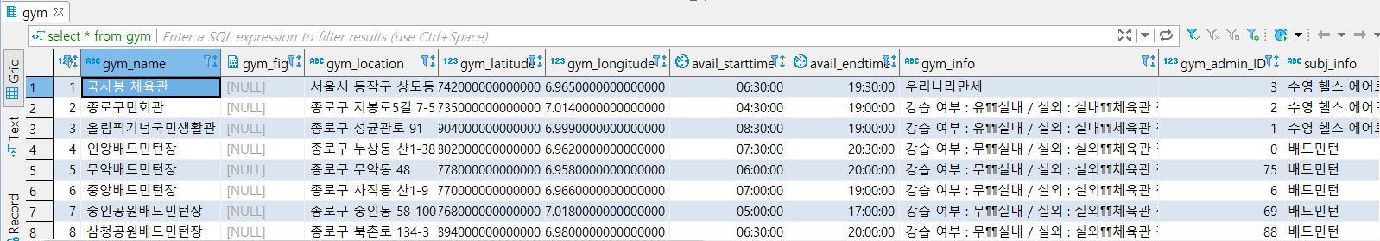
3. Implementation : DB Data Generation
Gym admin table (224 rows) : Contain gym admin information / PWD Encrypted (AES Algorithm)
Gym table (211 rows) : Contain whole gyms in Seoul

Slide 12
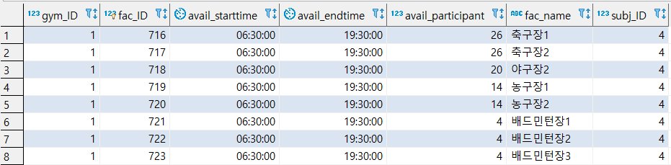
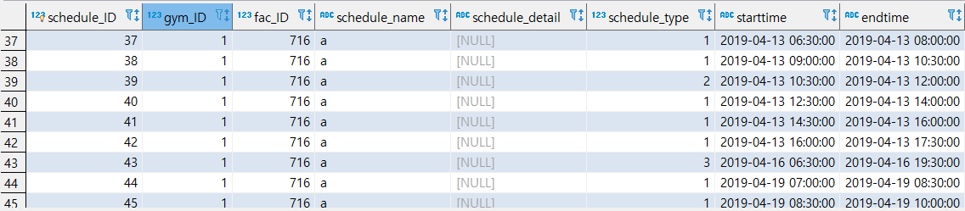
3. Implementation : DB Data Generation
Fac_info table (738 rows) : Contains facility information
Facility Schedule Types
1 | Reserved
2 | Open match
3 | Closed
4 | Tournament
Fac_schedule table (91 rows) : Contains schedules for each facilities)
Total rows in fac_schedule table expected : 738 x 90 = 66420 rows

Slide 13

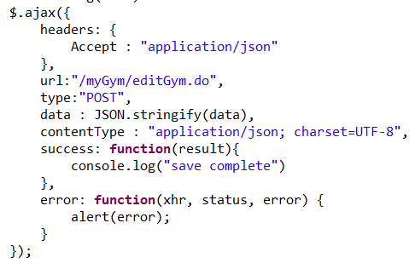
3. Implementation : Web Page Encoding Problem
Cannot print Korean character on web page
Set encoding properties on each jsp file / ajax / Spring controller / DB
JSP file
AJAX
Notes:
Schedule – For Month, For Week 페이지 개발
FullCalendar Library 사용
월별, 주별 일정 등록 및 수정, 삭제 기능 구현
색깔 별 일정 구분 기능 추가
jQuery 사용하여 페이지 동적 변동을 적용
추후 디테일한 입력 항목 추가 예정

Slide 14
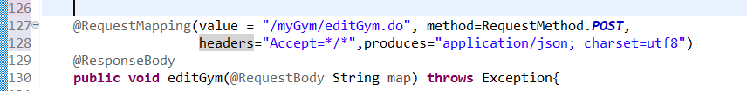
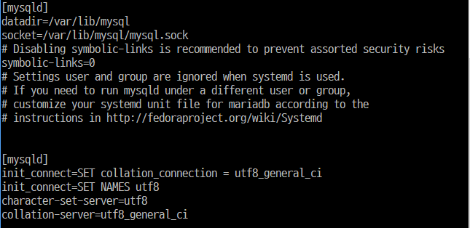
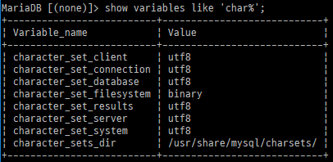
3. Implementation : Web Page Encoding Problem
Spring Controller
Database(MySQL)
Notes:
Schedule – For Month, For Week 페이지 개발
FullCalendar Library 사용
월별, 주별 일정 등록 및 수정, 삭제 기능 구현
색깔 별 일정 구분 기능 추가
jQuery 사용하여 페이지 동적 변동을 적용
추후 디테일한 입력 항목 추가 예정

Slide 15
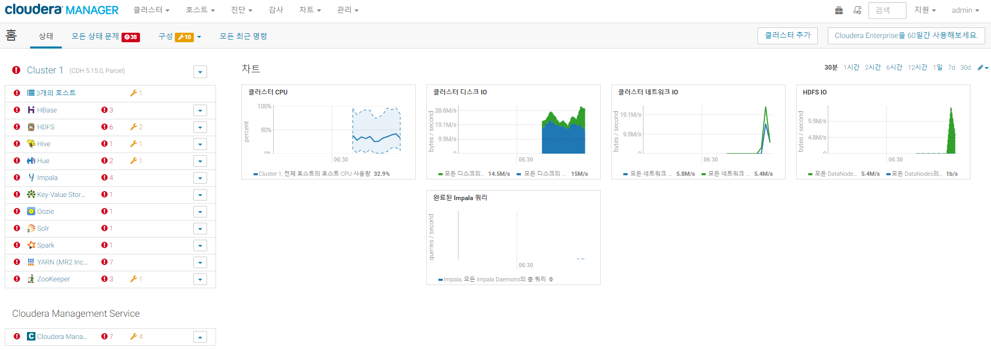
3. Implementation : Hadoop Cluster Construction
Necessary to implement ‘Recommendation Function’
Import / Export data from RDB(MySQL) and analyze data adapting Lambda Architecture
Data Import / Export : Sqoop
Data analysis : Hive, Impala, Spark
Schduling : Oozie
Notes:
Spring Base Structure Developed
Servlet configure : RequestMapping을 위한 기본 설정
Maven configure : 배포 및 외부 라이브러리 사용을 위한 Maven Pom.xml 설정
Interceptor Implementation : 로그인 세션 유지 및 페이지 권한 설정을 위한 Pre-Post Interceptor 구현
Controller Implementation : Dispatch된 Request를 분기하여 처리하기 위한 Method를 선언 및 구현.
Business Logic Implementation(Service Layer) : Controller가 이용할 서비스 모듈 (데이터베이스로 자료를 읽거나, 해당 자료를 통한 연산 등) 구현
Database Connection(Mybatis – MySql) : 데이터베이스 쿼리 처리를 위한 Mybatis 설정. 기초 쿼리 구현 및 데이터베이스 접근을 위한 DAO객체 구현.
View Resolver (JSP, JSTL) : Spring MVC에 따른 View 구현. JSP, JSTL를 이용하여 페이지 개발.

Slide 16
Personal Project Schedule

Slide 17
4. Personal Project Schedule
Lee, Donghyun : DB Construction & Data Analysis, Recommendation Implementation
Dates | March |  |  |  | April |  |  |  |  | May |  |  |  | June
Task Descriptions | 4 | 11 | 18 | 25 | 1 | 8 | 15 | 22 | 29 | 6 | 13 | 20 | 27 | 3 | 10 | 17
Team Organization |  |  |  |  |  |  | Midterm Demonstration & Presentation |  |  |  |  |  |  | Final Demonstration & Presentation
Subject Confirmation / Write out the Proposal
Data collection & Generation / Data modeling
Database Construction
Hadoop Installation / CDH Cluster Construction
Data Analysis using Hadoop Cluster
Functional Implementation : Matching Service (App)
Functional Implementation : Ranking System (App)
Test and Debugging
Preparing for Final Demo
Writing Manuals and Reports

Slide 18
4. Personal Project Schedule
Gong, Chanhyung : Web Structure construction, Web & app implementation
Dates | March |  |  |  | April |  |  |  |  | May |  |  |  | June
Task Descriptions | 4 | 11 | 18 | 25 | 1 | 8 | 15 | 22 | 29 | 6 | 13 | 20 | 27 | 3 | 10 | 17
Team Organization |  |  |  |  |  |  | Midterm Demonstration & Presentation |  |  |  |  |  |  | Final Demonstration & Presentation
Subject Confirmation / Write out the Proposal
Web UI Design
Web Structure Construction
Functional Implementation : Manager Web Site
Functional Implementation : Matching Service (App)
Functional Implementation : Ranking System (App)
Test and Debugging
Preparing for Final Demo
Writing Manuals and Reports

Slide 19
4. Personal Project Schedule
Geum, Kanghyeon : App Structure construction, Web & App implementation
Dates | March |  |  |  | April |  |  |  |  | May |  |  |  | June
Task Descriptions | 4 | 11 | 18 | 25 | 1 | 8 | 15 | 22 | 29 | 6 | 13 | 20 | 27 | 3 | 10 | 17
Team Organization |  |  |  |  |  |  | Midterm Demonstration & Presentation |  |  |  |  |  |  | Final Demonstration & Presentation
Subject Confirmation / Write out the Proposal
App UI Design
App Structure Construction
Functional Implementation : Manager Web Site
Functional Implementation : Reservation (App)
Functional Implementation : Matching Service (App)
Functional Implementation : Ranking System (App)
Test and Debugging
Preparing for Final Demo
Writing Manuals and Reports

Slide 20
Q & A

